Slide 1
Organ system modeling
Austin Baird
Department of surgery, division of healthcare simulation sciences
May 9, 2024

Slide 2
Outline
Model Design of BioGears Engine
Discussion of Sepsis – One Application
System Biology Deep Learning
Notebook Implementation
Brining it Back

Slide 3
Model and Design
Design a platform for human physiology simulations

Slide 4













BioGears model overview
Renal:
Filtration and urine production
GFR/RBF
Autoregulation
Want to construct a whole-body model of trauma physiology
Inhaler
Anesthesia Machine:
Ventilator mask or intubation
Equipment leak
Gas sources
Relief valve
Respiratory
Gastrointestinal:
Nutrient absorption/digestion
Eat meals, drink water
Cardiovascular
Blood
Tissue
Energy:
Thermal feedback and metabolic demands
Exercise
Environment
Nervous:
Sympathetic/Parasympathetic responses
Pain
Chemo/Baroreceptors
Extravascular
Intracellular
Lymph
Drugs:
Administration, kinetics, and dynamics
Opioid
Sedative
Antibiotic
Anesthetic
Endocrine:
Hormone regulation models
Epinephrine
Insulin
Glucagon
Hepatic:
Nutrient storage and conversion
Gluconeogensis
Lipogensis

Slide 5
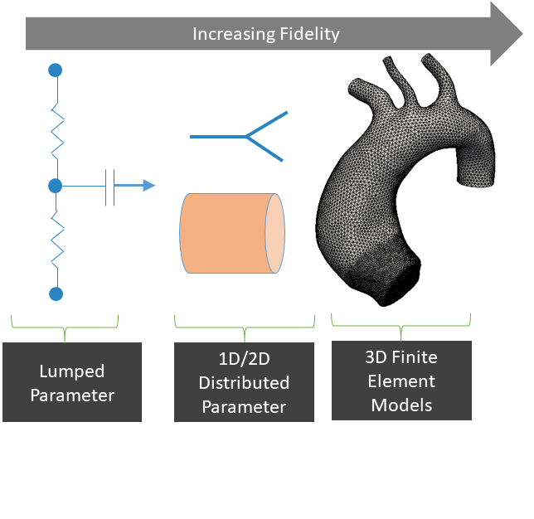
BioGears Circulation Model
Physics based circulation model: Lumped Parameter (0-D)
Fluid circuit analogue
No spatial element
Properties calculated at each node
Pressure
Flow rate
Volume
Enhancing circuit resolution improves approximation
Lower computational cost than higher fidelity models
Appropriate for global distributions
Decreasing Computational Cost

Slide 6
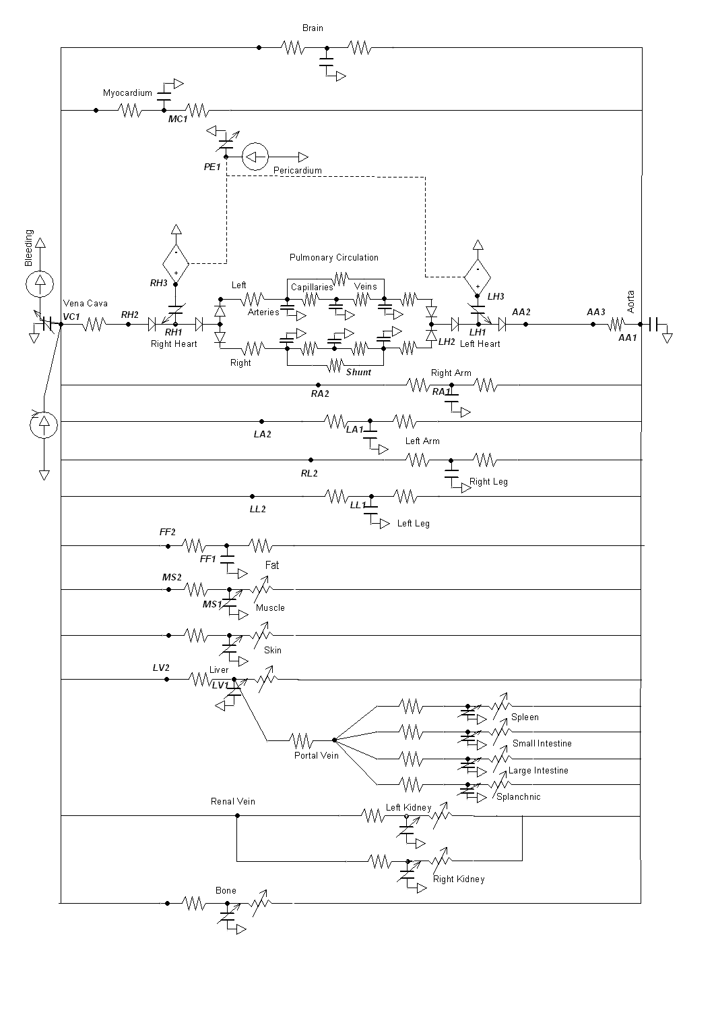
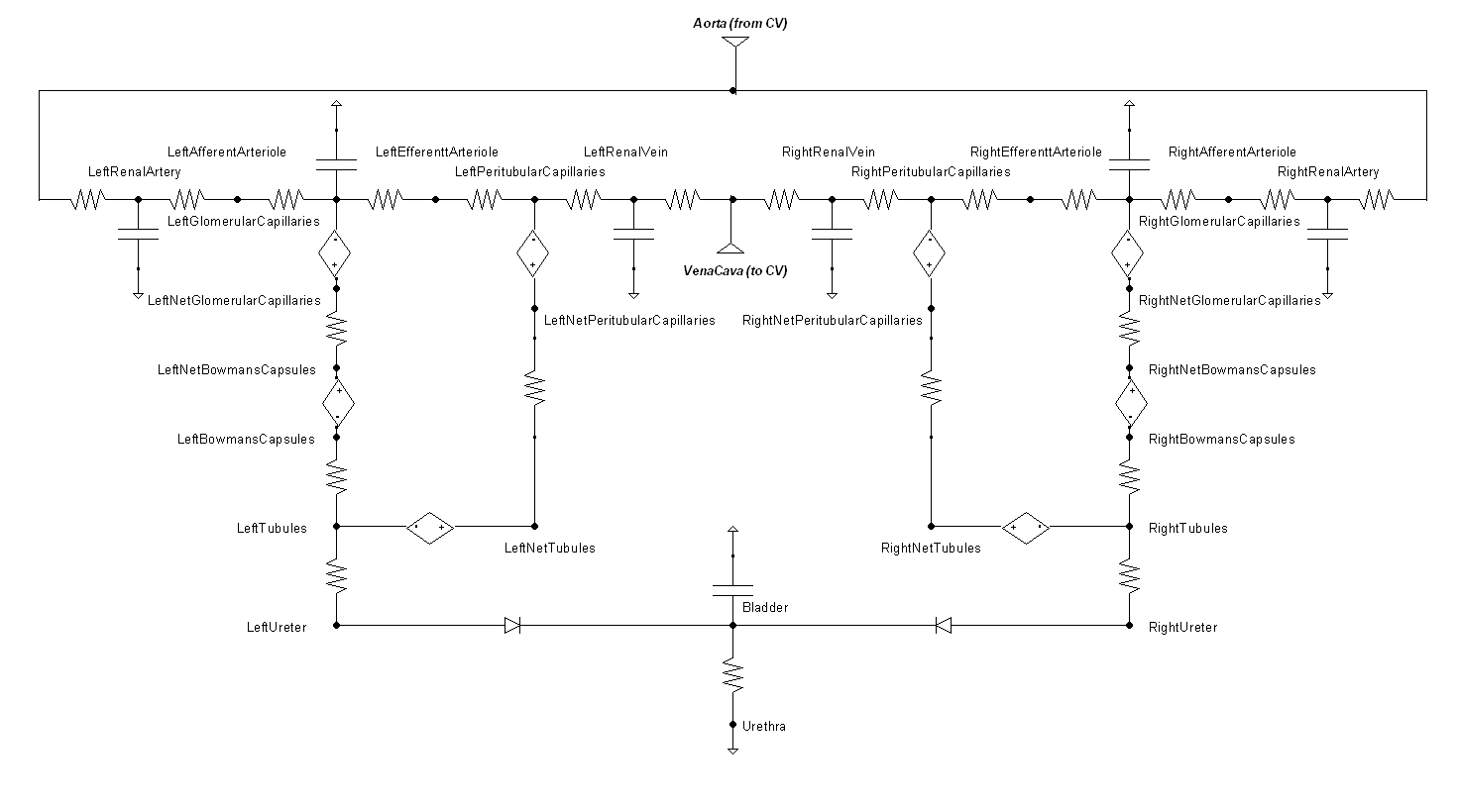
BioGears Circuit Model
Cardiovascular Circuit
Increased Spatial Resolution of Renal System at a Single Temporal Scale
Renal System

Slide 7
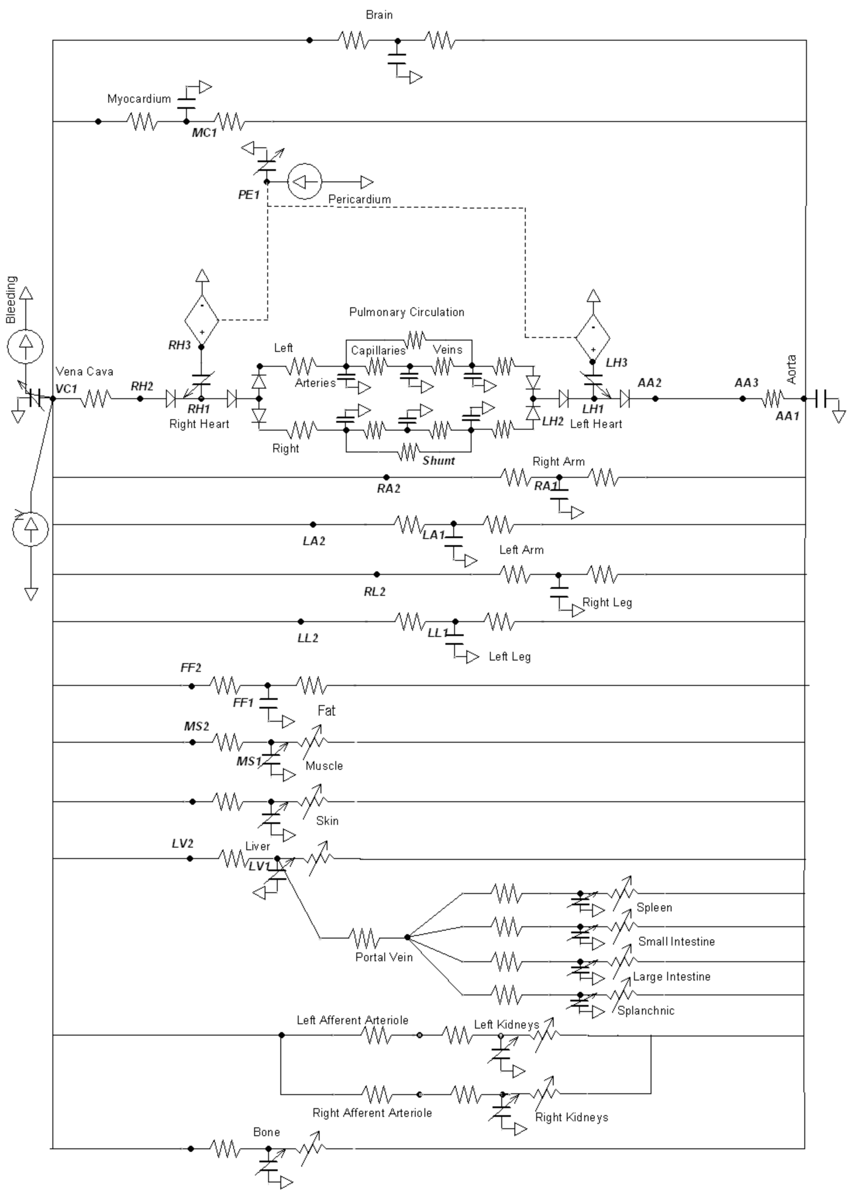

BioGears Compartments
Brain
Heart
Total Compartments
In total 154 total compartments with mapped hierarchy
Vascular Compartments
In total 60 liquid compartments with mapped hierarchy
Lungs
Pulmonary Compartments
In total 17 gas compartments with mapped hierarchy
Arms
Legs
Tissue Compartments
In total 40 liquid compartments with mapped hierarchy
Core
Environment Compartments
In total 20 thermal compartments with mapped hierarchy
Liver
Miscellaneous Compartments
In total 4 liquid urine compartments, 1 liquid lymph compartment, and 12 gas anesthesia machine and inhaler compartments
Gut
Kidneys
Core

Slide 8
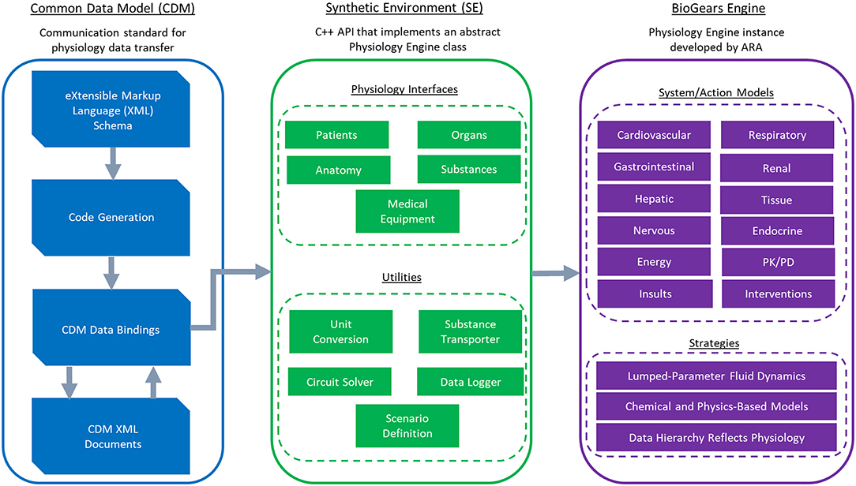
Engine Software Architecture

Slide 9
Sepsis
Using BioGears to construct a whole-body model of sepsis

Slide 10
Sepsis Overview
Array of dysregulated physiology in response to infection
Changes result in sever tissue damage and can be life threatening
Patient who acquire sepsis in the hospital have a mortality rate of 25% [1]
Sepsis accounts for 6.2% of the aggregate costs for all hospitalizations [2]
Around 23.7 billion annually, making it the most expensive condition treated in the hospital [3]
Detected due to infection analysis and sequential organ failure assessment
Introduced as part of sepsis-3 definitions [4]
Still does not fully capture complexity of the syndrome
Numerous potential mediators, host responses, and organ system interacts affect the evolution of sepsis within an individual patient
Similarly, there is still no protocol-based resuscitation methods that have shown to improve patient outcomes [5][6][7]
Want to improve patient outcomes using a mathematical modeling
Through healthcare simulation
Training simulations, not computational simulations. May be a manikin, actor, or computer game
Investigations into possible patient in-silico clinical trials
Still a very long ways to go

Slide 11
Motivation: Patient Treatment REFRESH Study
Pink = shared treatment
Grey = control
Red = test
All experimental data taken from [19][20]
Begin maintenance fluids at a rate of 1 mL/kg/h
0.18 ug/kg/min of norepinephrine administered
Maintained at a constant rate
Begin with 4.5 g piperacillin/tazobactam administration intravenously over 30 min
Dose recommended by ICU doctors at UW
We check for UO < 0.625 mL/min,
Supplemental bolus was only 250 mL if UO was not met
Prior to septic shock onset, we administer 500 mL of fluid over an hour
Confirm SBP < 100mmHg
Control patient received a second 1000 mL fluid bolus
No norepinephrine administered
Check SBP, MAP, and urine output each half hour for 6 hours
Introduce additional 500 mL of fluid
UO < 0.625 mL/min
If SBP and MAP exceeded 90mmHg and 65 mmHg we discontinued protocol
Initiated maintenance fluids at 75 mL/hr

Slide 12
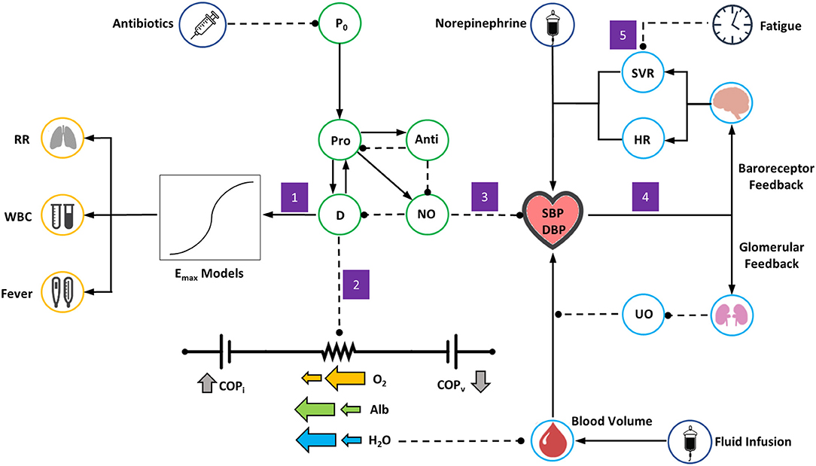
Sepsis Design
(1) The presence of inflammation and tissue damage leads to symptoms of systemic inflammatory response, modeled by general E_{max} relationships
(2) As damage worsens, the resistances on all vascular-tissue endothelial pathways on the BioGears cardiovascular circuit decrease, leading to hypovolemia and hypoalbumeria and a tendency toward hypotension
(3) Nitric oxide accumulation exerts an additional hypotensive effect
(4) Hypotension induces a response from baroreceptor and glomerular feedback models. Baroreceptor feedback increases systemic vascular resistance (SVR) and heart rate (HR). Glomerular feedback increases fluid retention, causing a drop in urine output (UO) that opposes volume loss
(5) As symptoms of systemic inflammation continue unabated, the ability of baroreceptors to increase SVR becomes inhibited

Slide 13
Sepsis Design
(1) The presence of inflammation and tissue damage leads to symptoms of systemic inflammatory response, modeled by general Emax relationships
(2) As damage worsens, the resistances on all vascular-tissue endothelial pathways on the, leading to hypovolemia and hypoalbumeria and a tendency toward hypotension
(3) Nitric oxide accumulation exerts an additional hypotensive effect
(4) Hypotension induces a response from baroreceptor and glomerular feedback models. Baroreceptor feedback increases systemic vascular resistance (SVR) and heart rate (HR). Glomerular feedback increases fluid retention, causing a drop in urine output (UO) that opposes volume loss
(5) As symptoms of systemic inflammation continue unabated, the ability of baroreceptors to increase SVR becomes inhibited

Slide 14
Sepsis Design
(1) The presence of inflammation and tissue damage leads to symptoms of systemic inflammatory response, modeled by general Emax relationships
(2) As damage worsens, the resistances on all vascular-tissue endothelial pathways on the BioGears cardiovascular circuit decrease, leading to hypovolemia and hypoalbumeria and a tendency toward hypotension
(3) Nitric oxide accumulation exerts an additional hypotensive effect
(4) Hypotension induces a response from baroreceptor and glomerular feedback models. Baroreceptor feedback increases systemic vascular resistance (SVR) and heart rate (HR). Glomerular feedback increases fluid retention, causing a drop in urine output (UO) that opposes volume loss
(5) As symptoms of systemic inflammation continue unabated, the ability of baroreceptors to increase SVR becomes inhibited

Slide 15
Sepsis Design
(1) The presence of inflammation and tissue damage leads to symptoms of systemic inflammatory response, modeled by general Emax relationships
(2) As damage worsens, the resistances on all vascular-tissue endothelial pathways on the BioGears cardiovascular circuit decrease, leading to hypovolemia and hypoalbumeria and a tendency toward hypotension
(3) Nitric oxide accumulation exerts an additional hypotensive effect
(4) Hypotension induces a response from baroreceptor and glomerular feedback models. Baroreceptor feedback increases systemic vascular resistance (SVR) and heart rate (HR). Glomerular feedback increases fluid retention, causing a drop in urine output (UO) that opposes volume loss
(5) As symptoms of systemic inflammation continue unabated, the ability of baroreceptors to increase SVR becomes inhibited

Slide 16
Sepsis Design
(1) The presence of inflammation and tissue damage leads to symptoms of systemic inflammatory response, modeled by general Emax relationships
(2) As damage worsens, the resistances on all vascular-tissue endothelial pathways on the BioGears cardiovascular circuit decrease, leading to hypovolemia and hypoalbumeria and a tendency toward hypotension
(3) Nitric oxide accumulation exerts an additional hypotensive effect
(4) Hypotension induces a response from baroreceptor and glomerular feedback models. Baroreceptor feedback increases systemic vascular resistance (SVR) and heart rate (HR). Glomerular feedback increases fluid retention, causing a drop in urine output (UO) that opposes volume loss
(5) As symptoms of systemic inflammation continue unabated, the ability of baroreceptors to increase SVR becomes inhibited

Slide 17
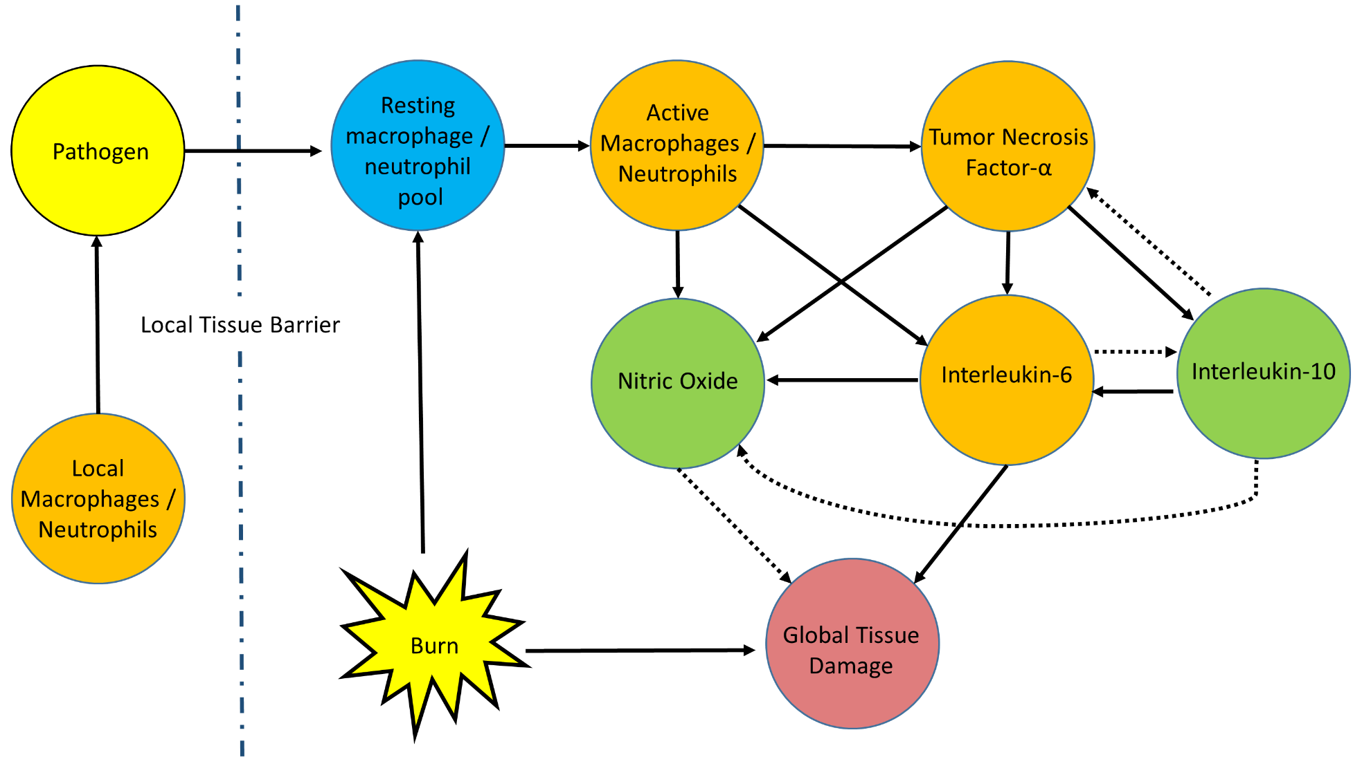
Sepsis Design: Inflammation Model
Pathogen invasion and thermal trauma initiate the inflammatory response model
Infection
Pathogen originates in tissue where it is combated by local immune mediators
Inflammation weakens tissue barrier integrity
Pathogen can enter circulation, leading to systemic inflammatory response (SIRS)
Burn^{[2,4]}
Thermal trauma activates systemic inflammatory response
Inflicts initial hit on global tissue health

Slide 18
Sepsis Model: Bacterial Growth and the Immune System
Extended and adapted model from [10]
Final term, Pb, is a relationship between the bacterial invasion/growth and the shock model
How the bacteria in the blood is interacting with circulating blood neutrophils
Hill equations are used to relate the interactions between bacterial and local immune responses
The final equation states that at high bacteria concentrations (above some P+ limit) the switch will be on to allow for neutrophils to the site of the infection
Low bacterial concentrations the tissue layer blocks the migration of neutrophils
Symbol | Description
Pt | Bacteria at the site of infection, initialized to begin an infection scenario
Mt | Local macrophages at the site of infection
Nt | Local neutrophils at the site of infection
B | The integrity of the local tissue at the site of infection. This barrier must be weakened for neutrophils to migrate to the infection site, facilitates bacteria translocation to the blood
Pb | Bacteria that has diffused to the blood from the infection site
R(t) | State of the toll like receptors, a “switch” that regulates the epithelial barrier integrity of the tissue that the bacteria has infiltrated
NA | Active blood neutrophil population

Slide 19
Sepsis Model: Systemic Inflammatory Response
Immune response to infection
We combine work from [11] and [12] and connect the model to our tissue model to induce hypotension, and fluid transport
We include a self-inhibition term to interlukin-6 to guarantee the existence of a stable fixed point
Some equations are omitted for brevity, the complete Acute Inflammatory Model (AIR) can be found in [13]
Symbol | Description
NA/MA | Active blood neutrophil/macrophage population
IL6 | Interleukin-6, later pro-inflammatory mediator which also downregulates TNF
TI | Tissue integrity, ranging from 1 (healthy) to 0 (irreversible damage) Depleted by IL6 and pathogen, moderated by NO
NO | Nitric Oxide, exerts hypotensive activity
TNF | Tumor necrosis factor, early pro-inflammatory mediator, upregulated by MA and NA

Slide 20
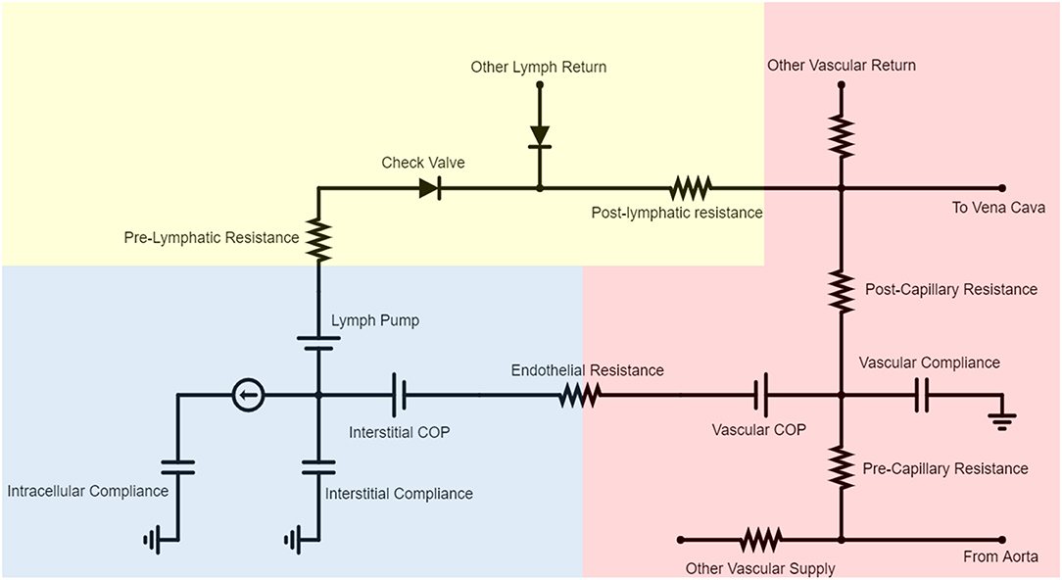
Sepsis Model: Microcirculation Model
Inflammatory-mediated tissue damage causes fluid shift and relative hypovolemia
Under normal physiological conditions we can describe this flux to be:
Compute COP using total plasma protein concentration, using the Landid-Pappenhaimer relationship [14]
Use the Patlak equation to determine albumin flux between each vascular-tissue compartment pair [15]
We model deterioration of the glycocalyx under severe inflammatory conditions by decreasing the endothelial wall resistance, R1 as a function of TI
We also decrease the reflection coefficient, sigma
Here sigma is the given tissue reflection coefficient, Pe is the peclet number and we are assuming a constant diffusion capacity (PS) across the entire diffusion distance

Slide 21
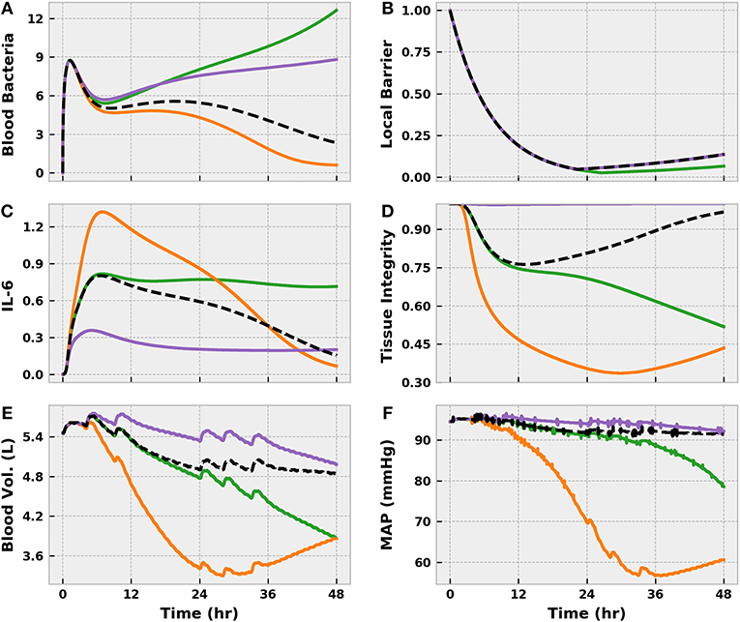
Results: Model strongly linked to parameterization
Wanted to investigate patient variability to a “moderate” bacterial response
“Susceptible” – Green
Decrease the rate of phagocytosis by tissue macrophages (kpm parameter)
“Hyperinflammatory” – orange
Increasing k6m and x66
Bacteria is eliminated by IL-6 levels remain elevated
“Immunosuppressed” – purple
Decreasing k6m and x66
Not a strong inflammatory response but blood bacterial levels remain elevated and tissue integrity continues to deteriorate
From the model:
k_{6M} (IL-6 recruitment by macrophages)
x₆₆ (IL-6 self-inhibition)

Slide 22
System Biology Deep Learning
Ok, we have these large system dynamics described, what do we do with them?

Slide 23
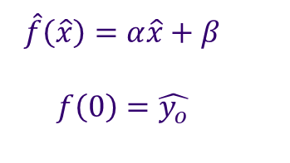
Motivating Example – Linear Regression
Say we see a strong relationship in the data:
Linear
Logistic
Oscillatory
Ect…
$$\hat{f}\left(\hat{x}\right)=α\hat{x}+β$$ $$f\left(0\right)=\hat{y_{o}}$$
Define the Model
Initial Observations
Proposed Hypothesis:
This looks linear!
Estimate Parameters
Test Model
Take your test set and tell me how well you did
Quantify Fit
Orange for back propagation!

Slide 24
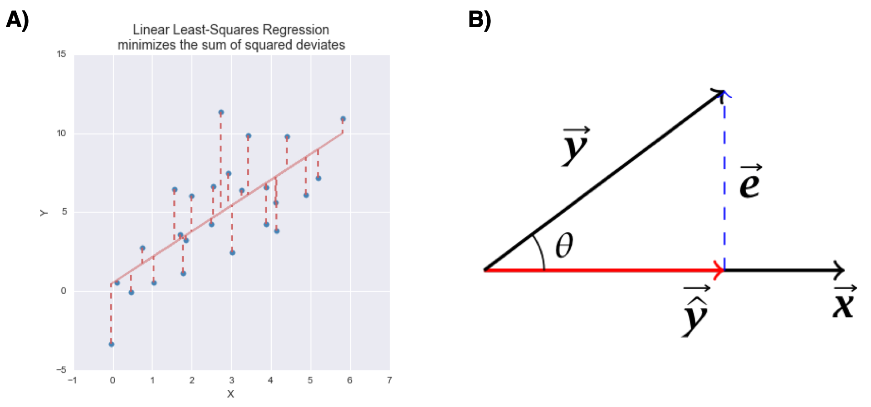
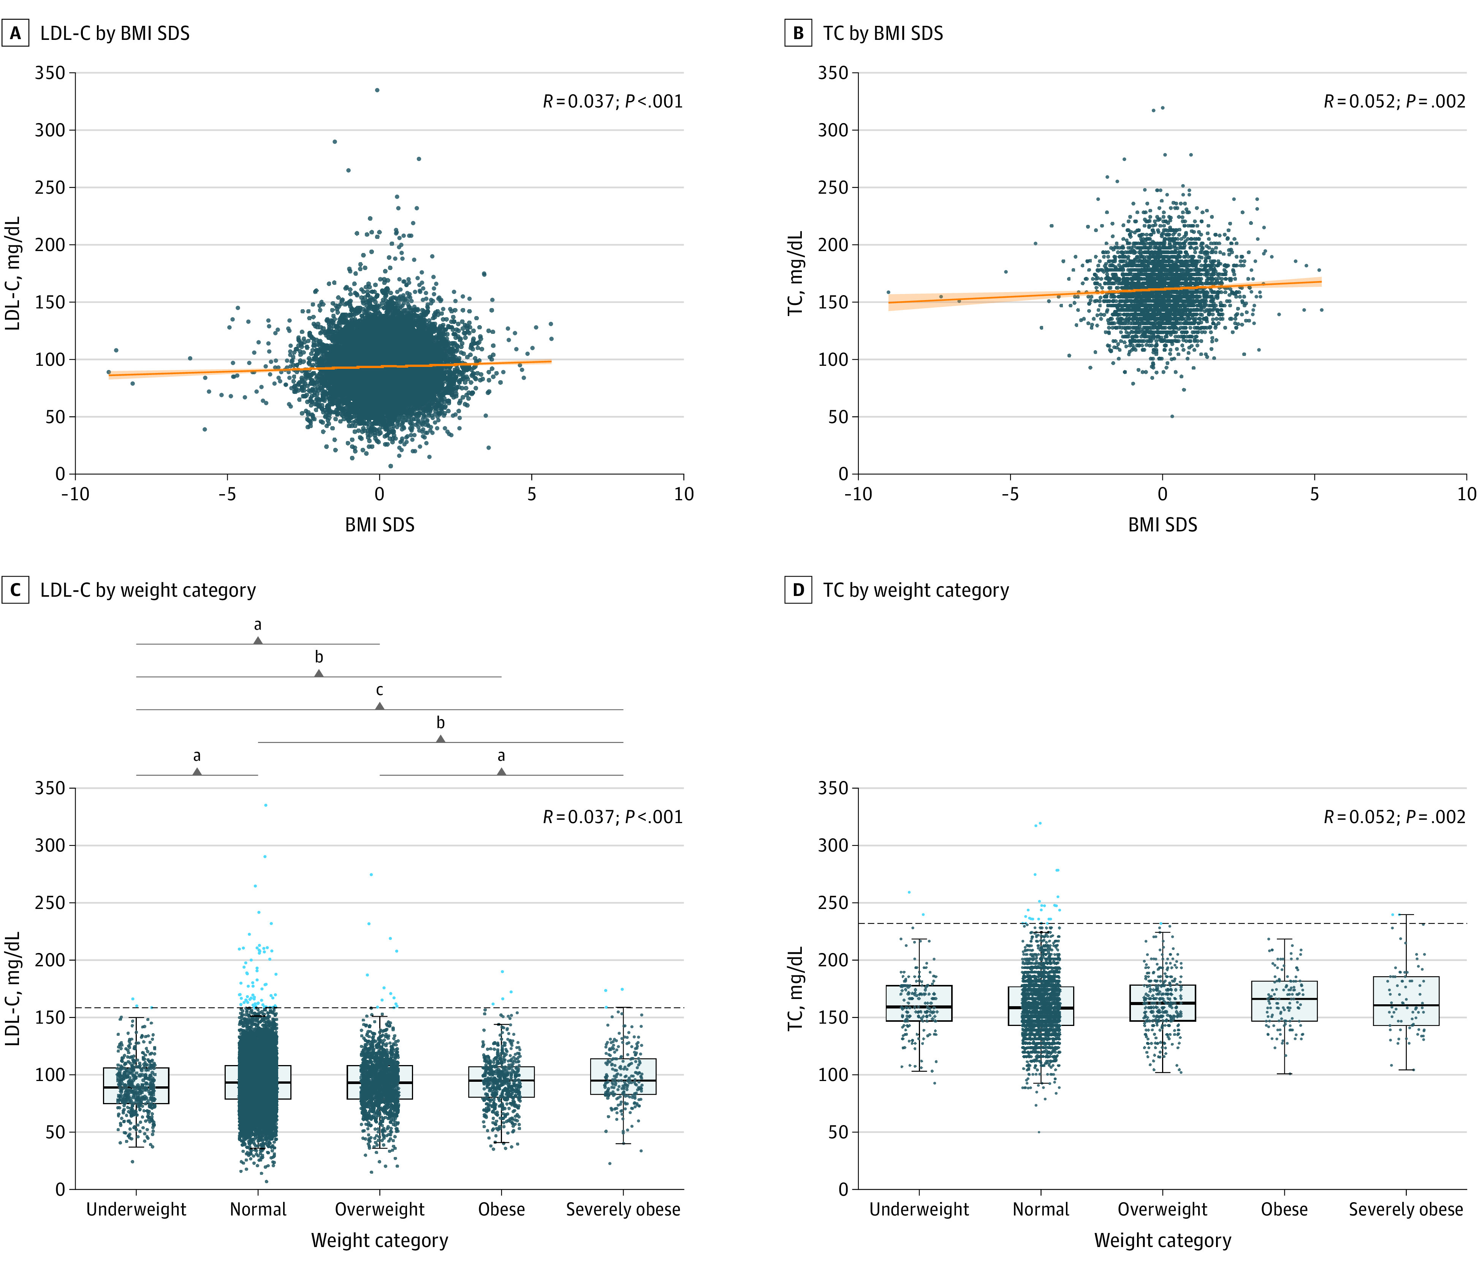
Motivating Example – Linear Regression
Real example – BMI and Cholesterol we assume to be linear
In fact this was published recently in jama (2023)
https://www.ncbi.nlm.nih.gov/pmc/articles/PMC10102874/
“Linear regression was used to study the association between LDL-C and TC level and body mass index standard deviation score (BMI SDS)”
We want a best fit model that minimizes our total error in the model
Note that for this example we don’t know actual function that determines these two things we are hypothesizing there is a linear relationship
Note that our regression model looks quite bad, but if we look at the figure in the JAMA paper is this so different?

Slide 25
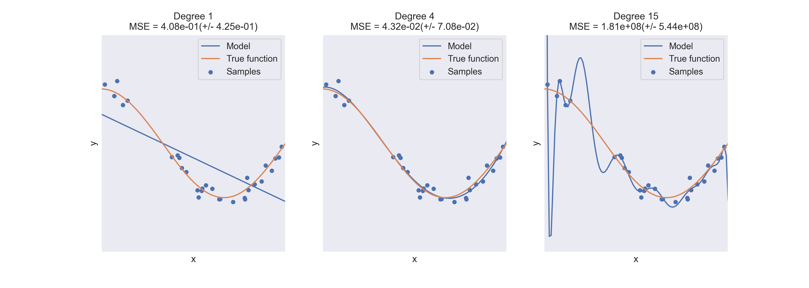
Motivating Example – Polynomial Regression
Here the “true” function is a cosine function
BUT a basis of polynomial functions DOES do a good job over the domain specified
Overfitting is an issue
BUT the coefficients of our fitted polynomial function will mean nothing regarding the true function that describes dynamics
Only valid within the training domain

Slide 26
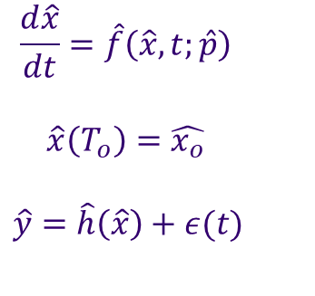
Systems Biology – ODE Model
Now say we don’t have the direct functional relationship,
we have a description of the dynamics evolving over time
Often informed by some experimental understanding of our system (mechanism)
No closed form solution
Large parameter space
$$\frac{d\hat{x}}{dt}=\hat{f}\left(\hat{x}, t;\hat{p}\right)$$
$$\hat{x}\left(T_{o}\right)=\hat{x_{o}}$$ $\hat{y}=\hat{h}\left(\hat{x}\right)+ε(t)$
We have a system with parameters p, and observations y which directly measure x and assume some level noise
Question: How is this a potentially problematic formulation?

Slide 27
Systems Biology – ODE Model
Now say we don’t have the direct functional relationship,
we have a description of the dynamics evolving over time
Often informed by some experimental understanding of our system (mechanism)
No closed form solution
Large parameter space
$$\frac{d\hat{x}}{dt}=\hat{f}\left(\hat{x}, t;\hat{p}\right)$$
$$\hat{x}\left(T_{o}\right)=\hat{x_{o}}$$ $\hat{y}=\hat{h}\left(\hat{x}\right)+ε(t)$
We have a system with parameters p, and observations y which directly measure x and assume some level noise
Question: How is this a potentially problematic formulation?
We are assuming the ability to directly measure the system
Test noise might be quantifiable

Slide 28
Systems Biology – ODE Model Motivation
Why do we want to use NN’s to help our formulation?
Experiments can only measure a subset of our equations
Glucose concentration
If we only have a subset of dynamics traditional parameter fitting methods may be insufficient
Universal function approximators
A deep net is one, so why not exploit that?
$$\frac{d\hat{x}}{dt}=\hat{f}\left(\hat{x}, t;\hat{p}\right)$$
$$\hat{x}\left(T_{o}\right)=\hat{x_{o}}$$ $\hat{y}=\hat{h}\left(\hat{x}\right)+ε(t)$
We have a system with parameters p, and observations y which directly measure x and assume some level noise

Slide 29

Systems Biology – ODE Model Motivation
What are the cons?
$$\frac{d\hat{x}}{dt}=\hat{f}\left(\hat{x}, t;\hat{p}\right)$$
$$\hat{x}\left(T_{o}\right)=\hat{x_{o}}$$ $\hat{y}=\hat{h}\left(\hat{x}\right)+ε(t)$
We have a system with parameters p, and observations y which directly measure x and assume some level noise

Slide 30
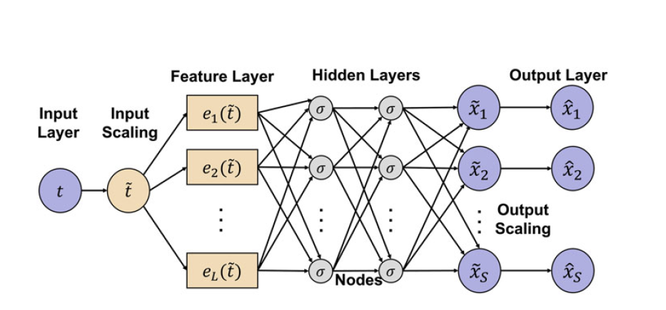
Systems Biology – ODE Model
Now we want to use deep learning to either:
Learn the dynamics (or “hidden physics” of the system)
Or learn the parameters
What's special?
Feature layer
Uses observed basis functions that could potentially describe dynamics
Scaling of the time domain (normalization)
Output scaling by the mean
Loss Function
Three loss function, one that is determined by the ODE
Note: there is no testing for varying feature layer: Is this a problem?

Slide 31
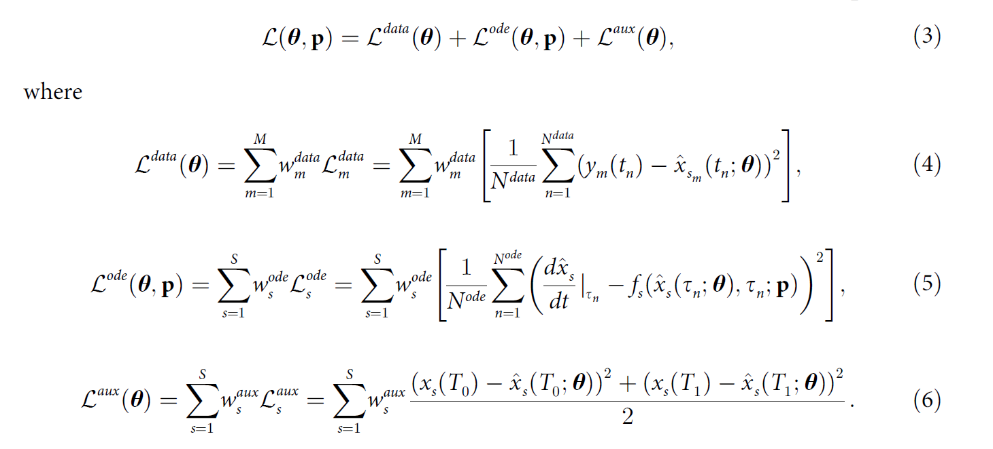
Systems Biology – ODE Model
Loss Function
Three loss function, one that is determined by the ODE
The “physics” of the system is embedded in the ode loss function
Still requires integration of the ode
Using automatic differentiation

Slide 32
Systems Biology – ODE Model
Now we want to use deep learning to either:
Learn the dynamics (or “hidden physics” of the system)
Or learn the parameters
What's special?
Feature layer
Uses observed basis functions that could potentially describe dynamics
Scaling of the time domain (normalization)
Output scaling by the mean
Note: there is no testing for varying feature layer: Is this a problem?
Why not just include a larger basis? What do we know about this feature layer?

Slide 33
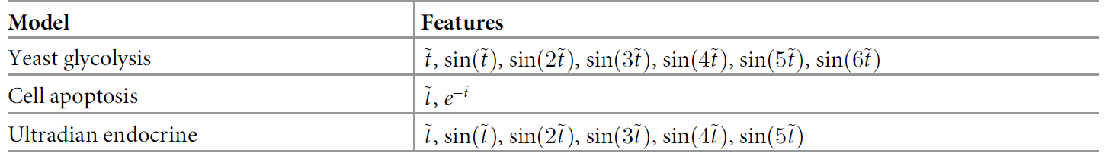
Systems Biology – ODE Model
To train:
Generate data with our model, adding in some noise (just like we did in our example!)
Only allow for two of the parameters as the training set
Test against noiseless and noisy
Feature layer varies based upon the observed dynamics of the system

Slide 34
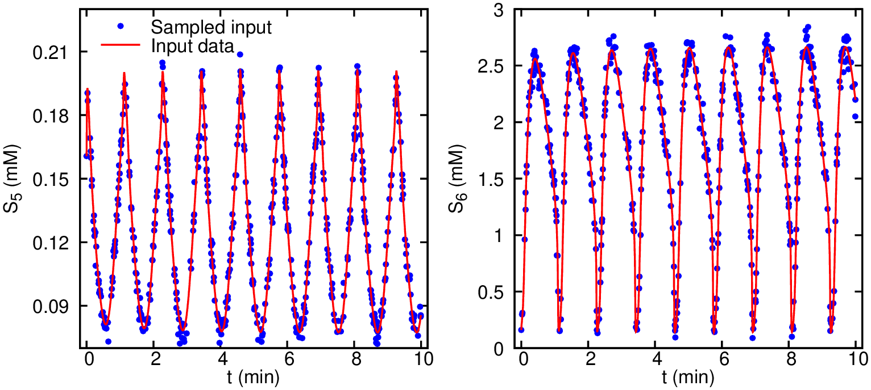
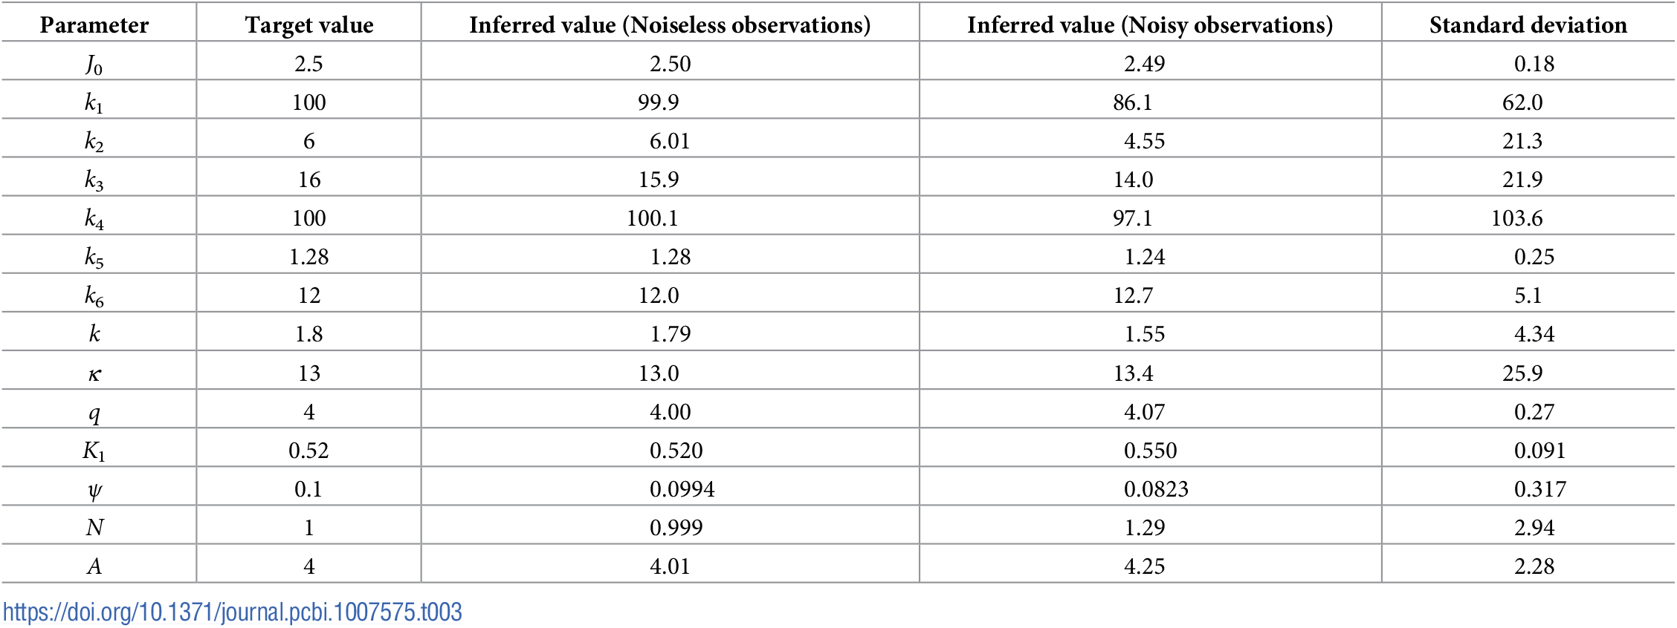
Systems Biology – ODE Model
10% noise added to the sampled space, we see our estimates break down quite a bit
We need to understand how noise impact estimation for these methods
Experimental data is NEVER noiseless
This seems like a red flag….

Slide 35
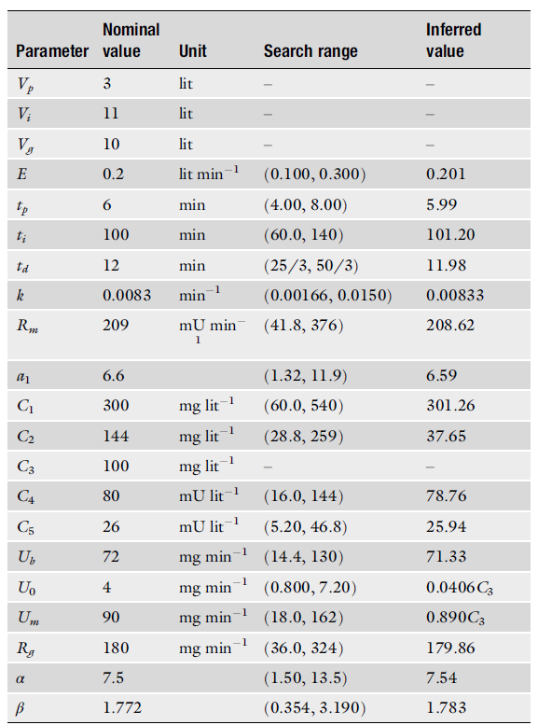
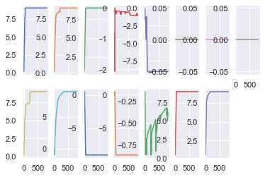
Systems Biology – ODE Model
What do the parameters look like on my machine?
There seems to be a reproducibility issue
BUT – just like any nonlinear system, these trained models can approach local min, bifurcations, saddle points, ect…
There are ways to account for this
My learned parameters seem to be at a local minimum

Slide 36
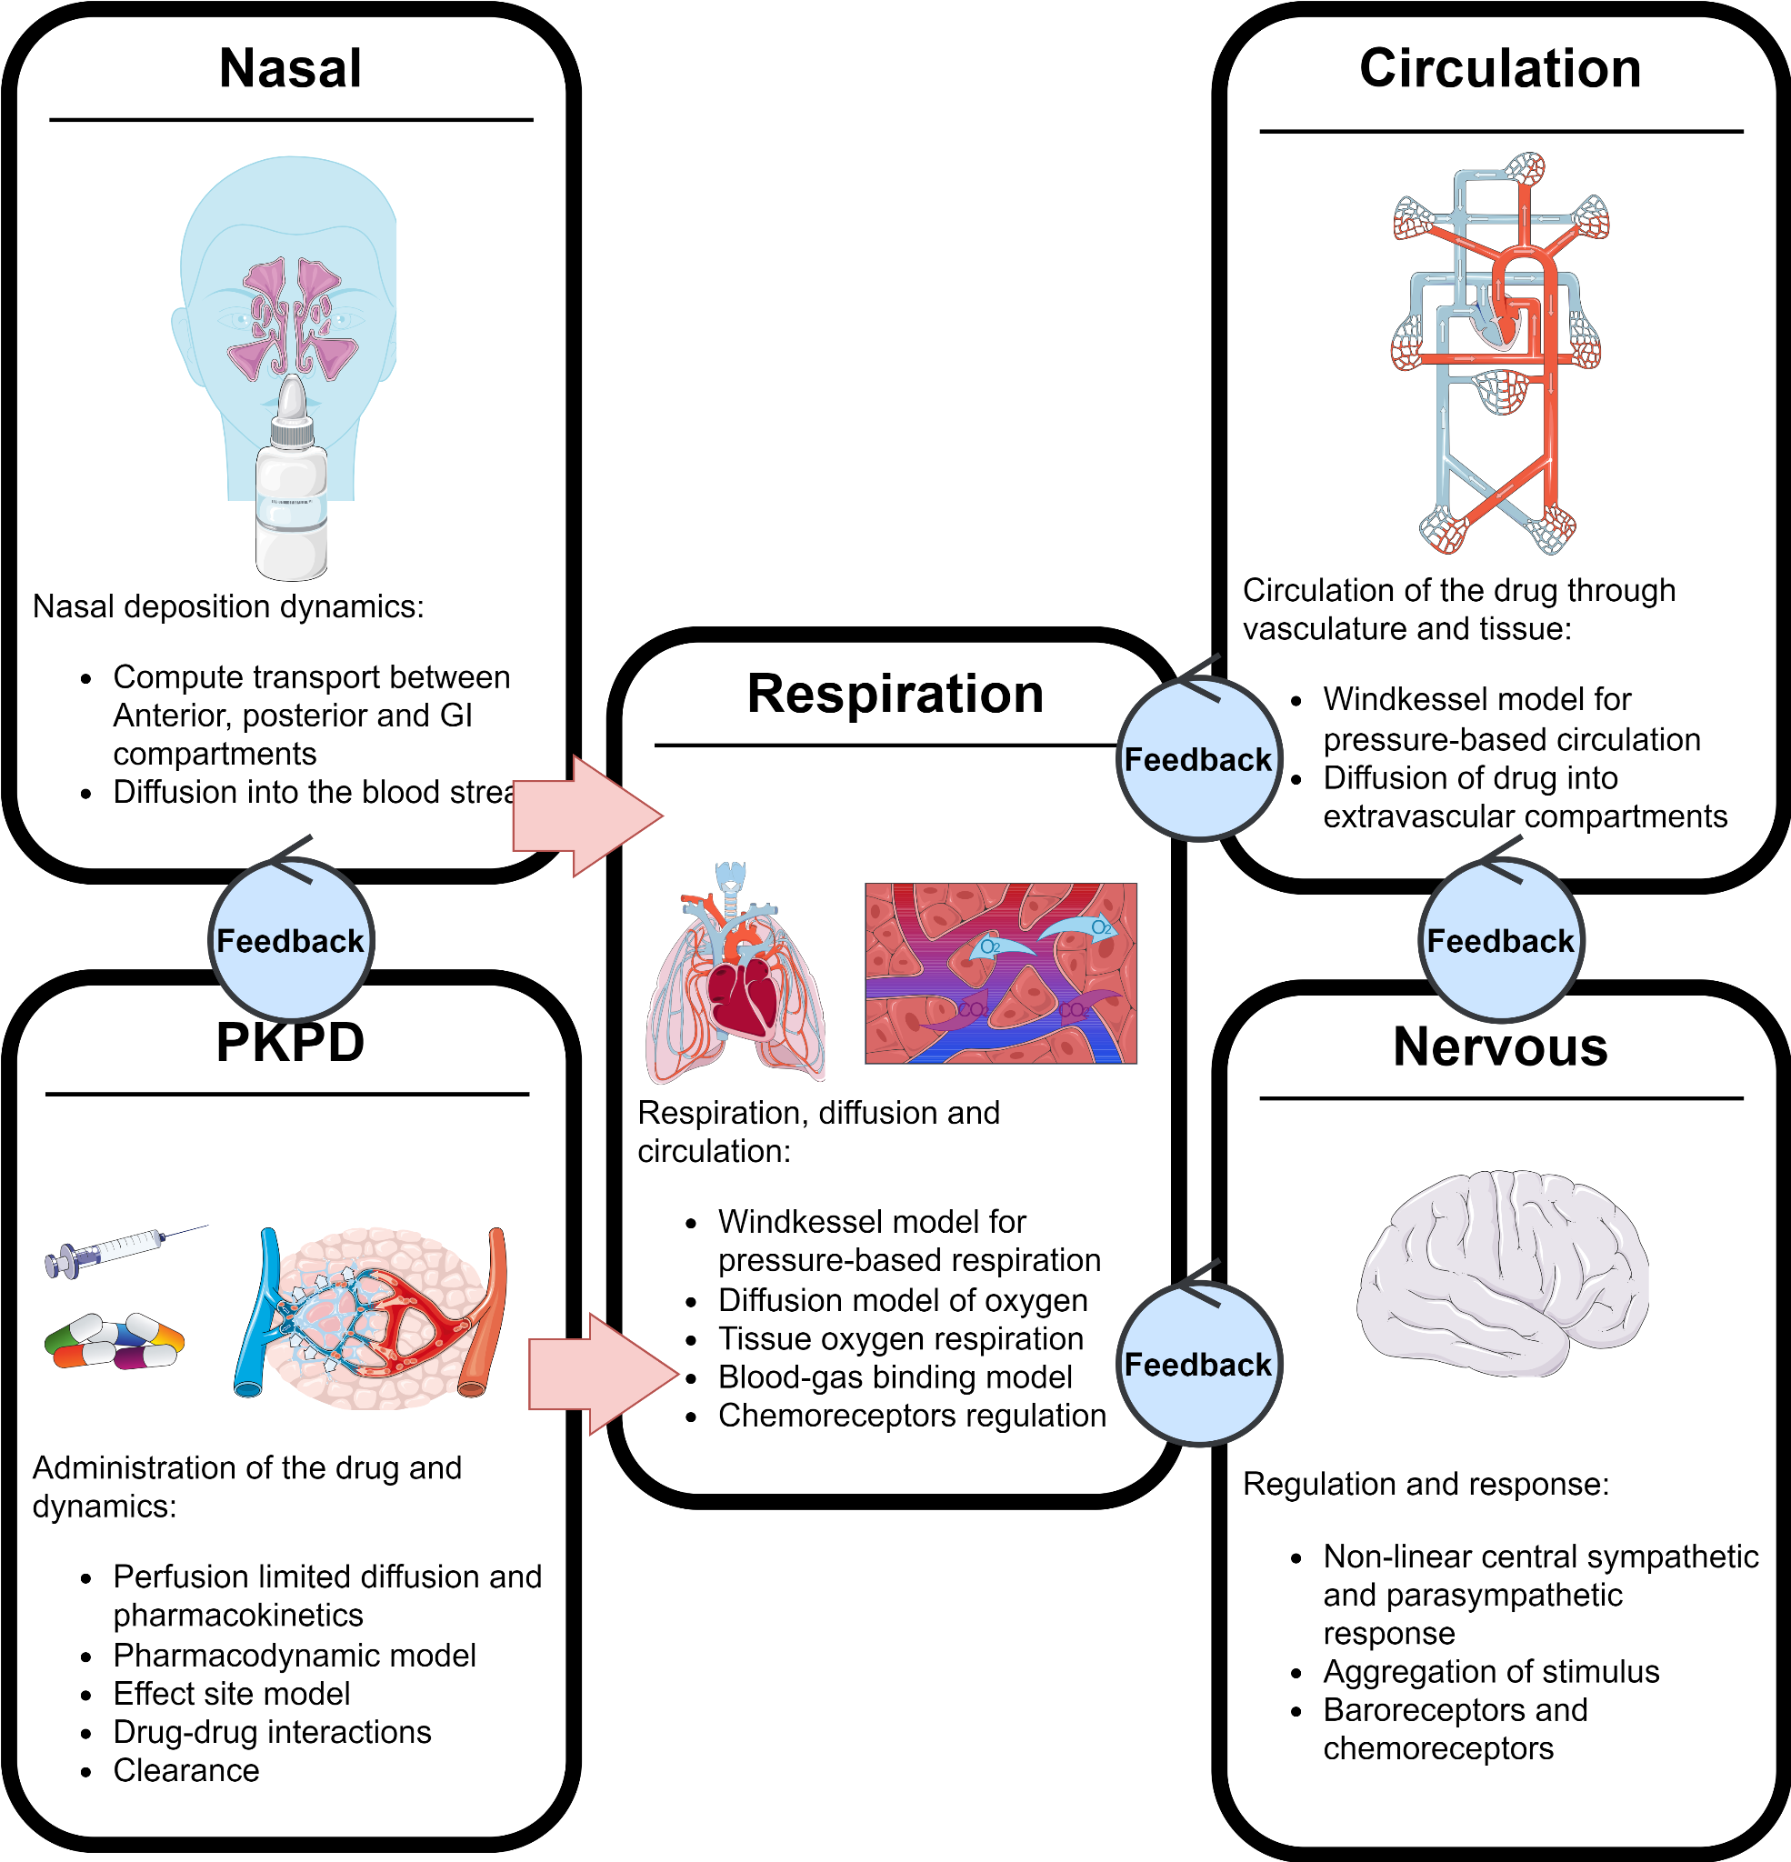
Systems Biology – Messy Systems, Messy Data
BUT – what data do we have access to?
And what are we modeling?
We want to model the whole-body physiological response to various trauma
AND model treatments during the simulation
This data is messy and almost NEVER measuring the value we want

Slide 37
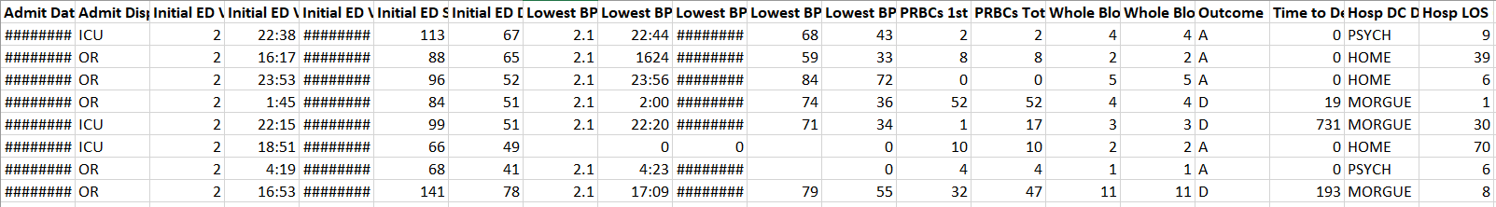
Systems Biology – Messy Systems, Messy Data
BUT – what data do we have access to?
And what are we modeling?
We want to model the whole-body physiological response to various trauma
AND model treatments during the simulation
This data is messy and almost NEVER measuring the value we want
How would we use this dataset to learn parameterization of inflammation during trauma?
In theory this is just one observed value of our system (maybe it would work?)
This is the open research question

Slide 38
Bringing it back
Where are we and where are the gaps?

Slide 39
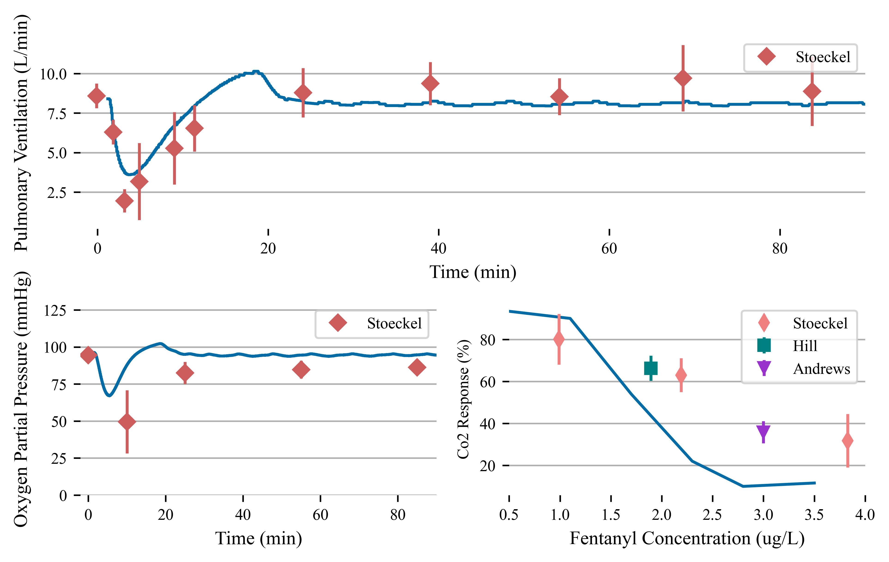
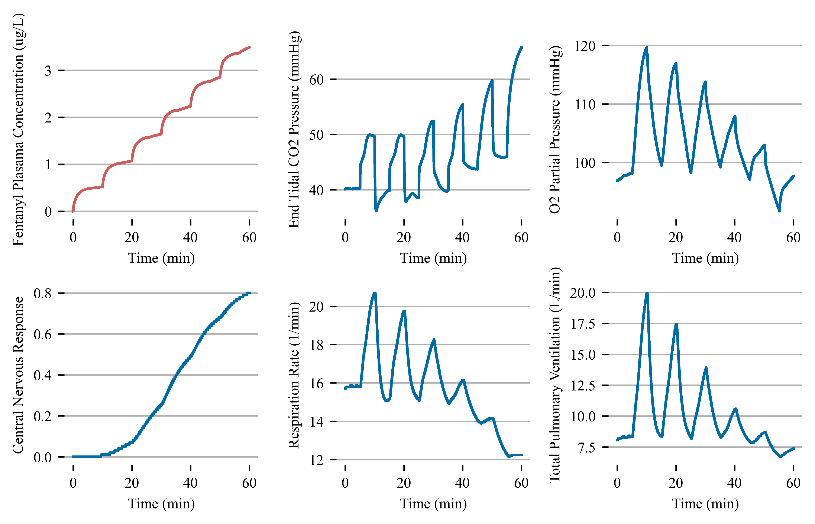
Current Work – Opioid Use
Using the data we have –
Whole-body physiology models can be well-validated by existing data
Might not be ready for deep nets…. Yet
Qualitative validation can lead to use cases in simulation and educational training for clinicians

Slide 40
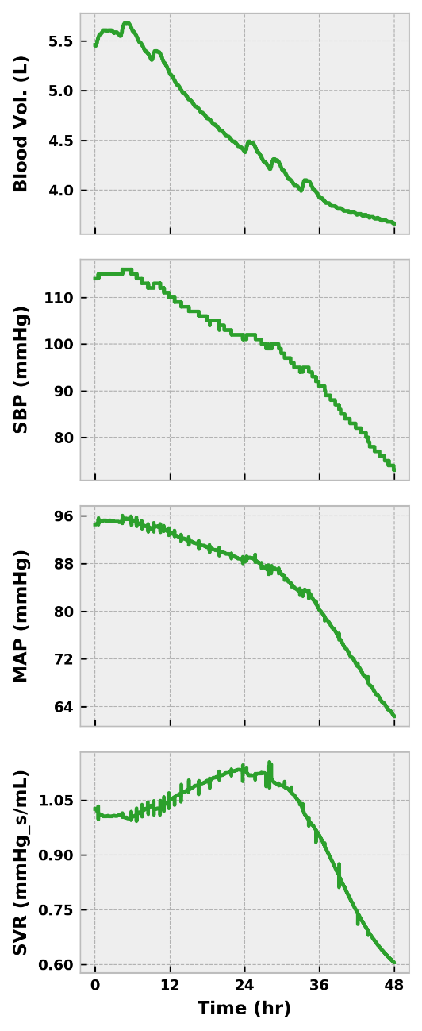
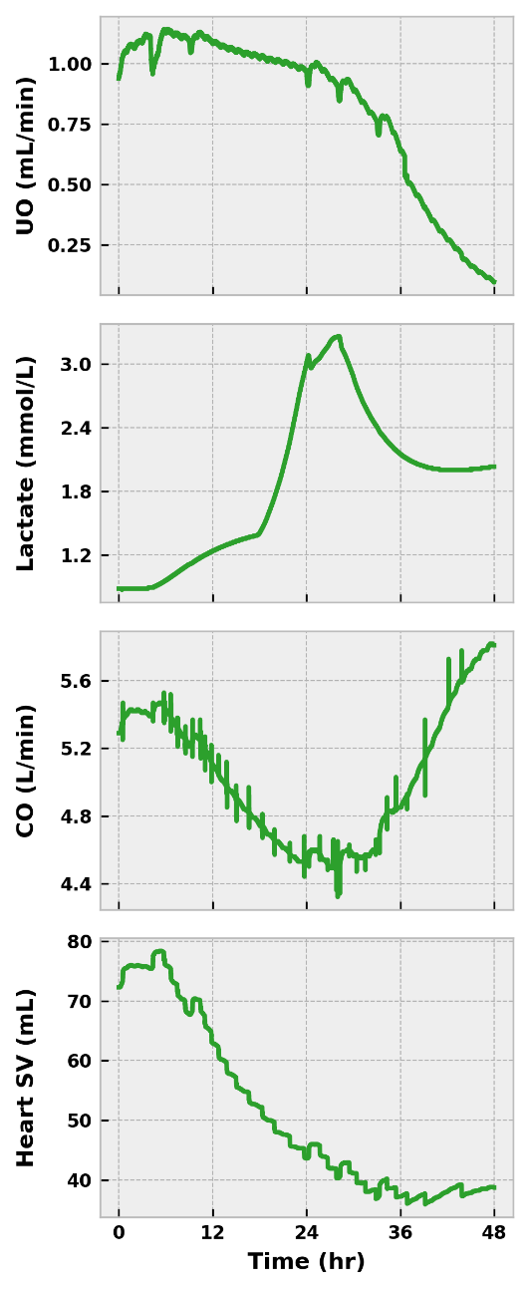
Current Work – Qualitative Validation for Sim
Clinically-relevant markers for sepsis and septic shock diagnosis according to Sepsis-3^{[21]} definitions*
Sepsis
Systolic blood pressure < 100 mmHg
Respiration rate > 22 (previous slide)
Renal organ failure assessment score
UO < 500 mL/day (0.34 mL/min) = 3
UO < 200 mL/day (0.14 mL/min) = 4
Septic Shock
MAP < 65 mmHg
Serum lactate > 2.0 mmol/L

Slide 41
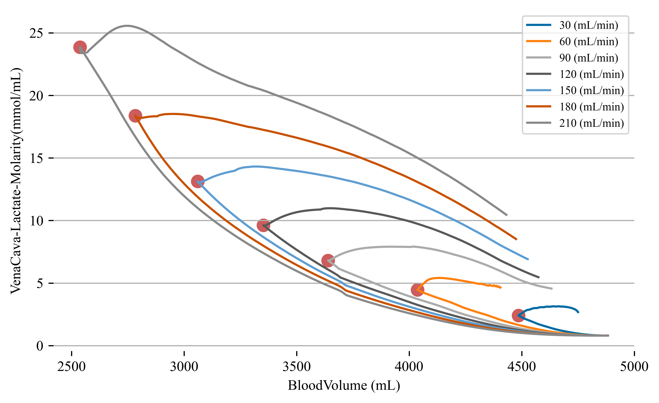
Current Work – Curvature as a function of patient state
Can the curvature of patient trajectories inform patient “status”?
For a hemorrhage patient can we triage as a function “turning points”?
Respiration:
Oxygen diffusion
Blood-gas binding
Tissue oxygenation
Tissue:
ATP requirements
Lactate production
Trauma induced inflammation
Circulation:
Pressure and fluid loss
Reperfusion

Slide 42
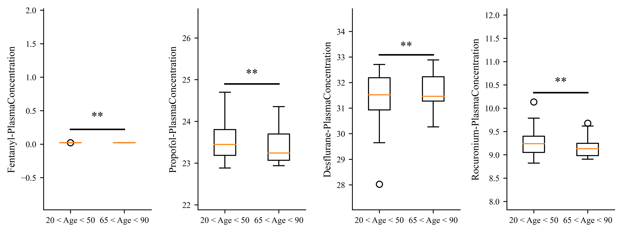
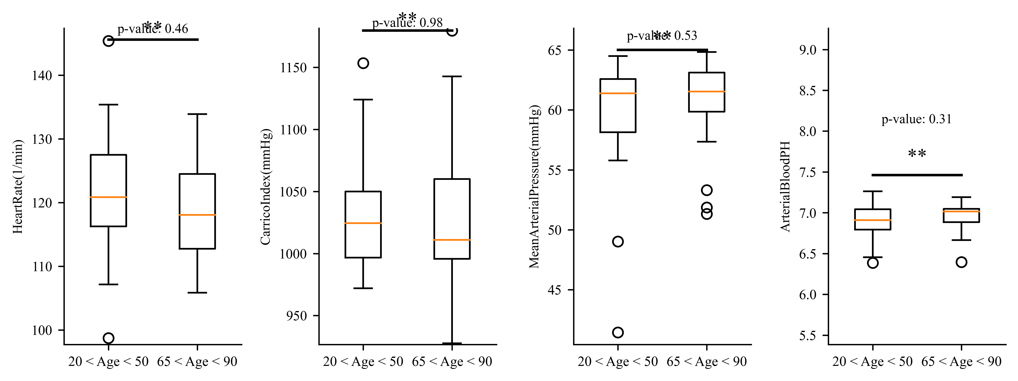
Current Work – Patient variability for geriatric anesthesia
Age informs drug clearance, especially acute for older individuals
Anesthesiologist are not well trained on patient response and physiology
Using a whole-body physiology model to construct age-related models

Slide 43

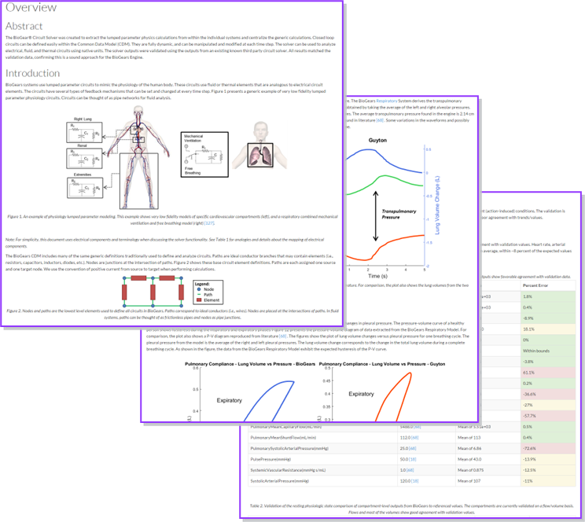

Computer models for simulation and education
Get involved!
https://github.com/DivisionofHealthcareSimulationSciences
https://github.com/BioGearsEngine/core
Biogears.dev

Slide 45
Sepsis Model: Microcirculation Model
Inflammatory-mediated tissue damage causes fluid shift and relative hypovolemia
Under normal physiological conditions we can describe this flux to be:
Compute COP using total plasma protein concentration, using the Landid-Pappenhaimer relationship [14]
Use the Patlak equation to determine albumin flux between each vascular-tissue compartment pair [15]
We model deterioration of the glycocalyx under severe inflammatory conditions by decreasing the endothelial wall resistance, R1 as a function of TI
We also decrease the reflection coefficient, sigma
Here sigma is the given tissue reflection coefficient, Pe is the peclet number and we are assuming a constant diffusion capacity (PS) across the entire diffusion distance

Slide 46
BioGears Circuit Model
By considering the fluid-circuit analog, we can use Kirchhoff's laws to solve for the circulation/ventilation using nodal analysis
The current at a given node sums to zero:
Stand up a matrix equation, solve for state of the cardio/pulmonary system

